Slide 1
Ch. 8 Communication Skills in Interpersonal Relations Providing Emotional Support, Managing Privacy, Negotiating Conflict CLO – 04: Identify workplace conflict and develop resolution strategies
EE Communication Skills (SS-2010) Spring 2025
Wk. 10.2

Slide 2
Learning Objectives (CLO - 04)
Describe Characteristics of Comforting Messages
Apply Disclosure and Privacy Strategies in Relationships
Inspect People Negotiating Needs, Wants, and Preferences
Manage Conflict in Relationships
Estimate Collaborative Approach to Conflicts

Slide 3
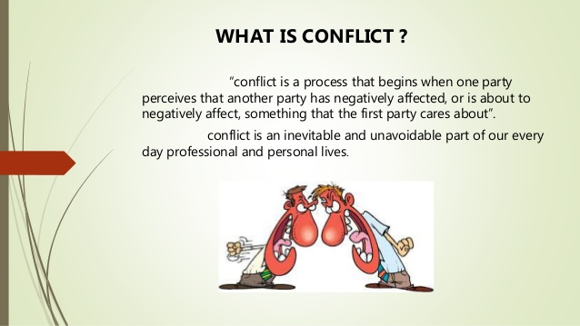

Slide 4
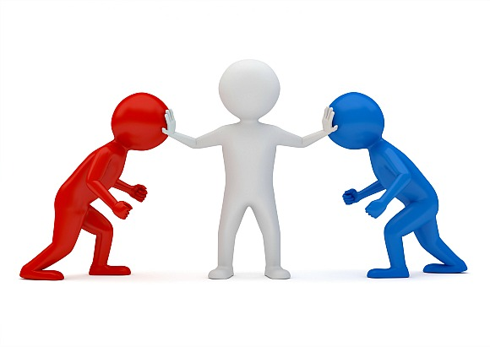
What is Conflict?
An expressed struggle between at least two interdependent parties who perceive incompatible goals, scarce resources, and interference from the other party in achieving their goals

Slide 5
4. Managing Conflict in Relationships
All relationships inevitably face/ experience conflict
Avoiding a conflict is a good strategy, but fails often
High performance teams view conflict as healthy and productive
Viewing of conflicts is different in different cultures
There are five styles to tackle/ manage conflict

Slide 6
Characteristics of Conflict
At least two people are required (interpersonal)
Involves a struggle/ incompatibility/ perceived differences among goals/ values/ desires/ perceptions
An action (without action, a conflict is latent)
Power/ attempts to influence (otherwise, it’ll be just a disagreement)

Slide 7
Views of Conflict
Traditional: all conflicts are harmful – must be avoided
Human Relational: conflict is a natural and inevitable outcome in any group
Integrationist: conflict is a positive and an essential component for a team to perform effectively
Functionalist: works towards the goals of an organization/ group
Constructive, increases info/ ideas, innovative, reduces stagnation
Dysfunctional: blocks an organization to attain goals
Destructive, reduces trust, reduces info, poor decisions, stressful, low tolerance

Slide 8
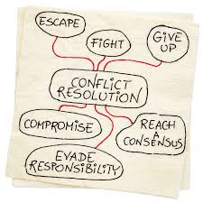
Conflict Management
‘the opportunity to improve situations and strengthen relationships’

Slide 9
The Five Styles of Conflict Management
Withdraw (Avoid)
Accommodate
Force (Compete)
Compromise
Collaborate

Slide 10
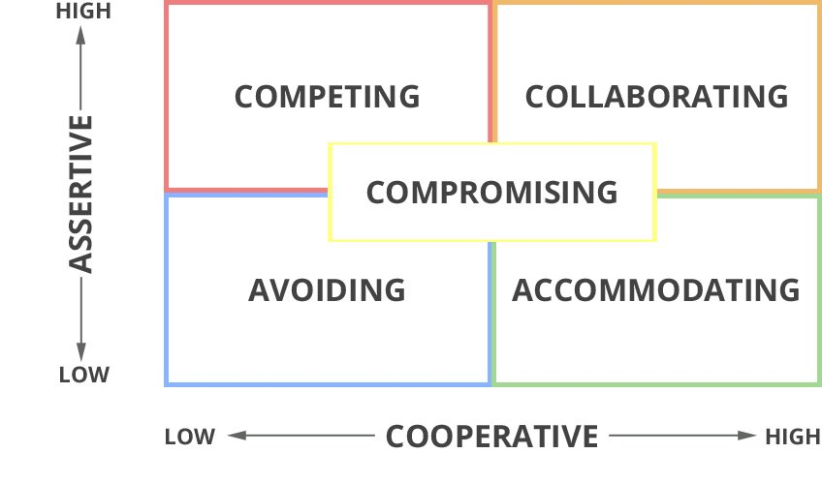

Slide 11
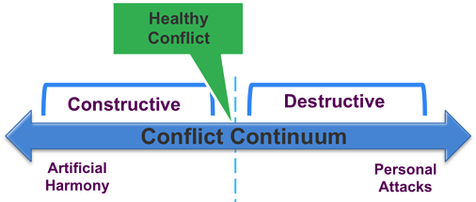
Conflict Continuum – In Other Words:
‘I win, you lose’ (Compete)
‘I lose or give in’ (Accommodate)
‘We both get something’ (Compromise)
‘We both WIN’ (Collaborate)

Slide 12
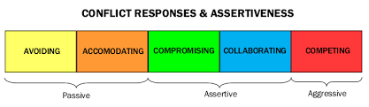
Conflict and the Associated Behaviour

Slide 13
5. Estimate Collaborative Approach to Conflicts - Guidelines
Identify the problem and own it as your own – seek appropriate solutions
Describe the problem in terms of behaviour, consequences, and feelings
Don’t evaluate the other person’s motives – refrain from blaming/ accusing
Find common ground – a resolution could start off
Mentally rehearse so you can state your request briefly
Disengage – put a mental shield and avoid defensive response
Respond empathically and with genuine interest and concern
Paraphrase your understanding of the problem – ask Qs to clarify
Ask the other person to suggest alternative solutions
Individuals should understand their personal triggers
Groups should consider the dynamics/ factors that may raise conflicts

Slide 14
References
1. Bovee & Thill. (2016) Business Communication Today 13th Ed. (Prentice-Hall)
2. Kathleen S. Verderber. Communicate (13th Ed.)

